Slide 1




Farm Loan Programs |
Guaranteed Loan Collateral

Slide 2

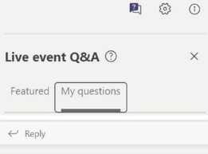
Microsoft Teams Town Hall Events
Instructions for the live event are listed below.
One–Direction Broadcast: As an attendee, you are not able to share your audio or video feed.
Closed Captioning: To turn on closed captions, click on the three-dot menu icon at top of your screen. A sub menu should appear with various options. Click on the option titled “Turn on Live captions”
Meeting Recording: This event is being recorded. A copy of this recording will be available on the Guaranteed Lender Toolkit site.
PowerPoint Slides: A copy of the slides will be available on the Guaranteed Lender Toolkit site.
Q&A: Participants may ask questions during the Town Hall using the Q&A feature. To see all questions posted, toggle between the Featured and My Questions tab.
Notes:
Please be reminded that TEAMS Live Events are recorded, and these recordings will be posted to the FLP Training Site for future reference. You can also access the recording by clicking the same link you used to access this event. And, if need to step away for a bit, you can use the pause feature in TEAMS.
Live Events allow for one-way video and audio. You are encouraged to ask or provide constructive questions or comments in the chat during the LIVE event, which can be done so anonymously. We will be collecting questions and comments to ensure they are addressed at future trainings. We anticipate providing written responses to questions in a shared frequently asked questions document.

Slide 3



Guaranteed Loan Security

Slide 4

2-FLP Collateral updates
Updates Adequate and Additional security definitions.
  Reduces subjective language
  Provide more lender autonomy
  Removes minimum and additional security definitions
Based on lender internal lending policy for similar non-guaranteed loans
  SEL/CLP provide an explanation on how security meets internal policy
  PLP based on their approved CMS
Adequate Security: Loan amount < security amount

Slide 5
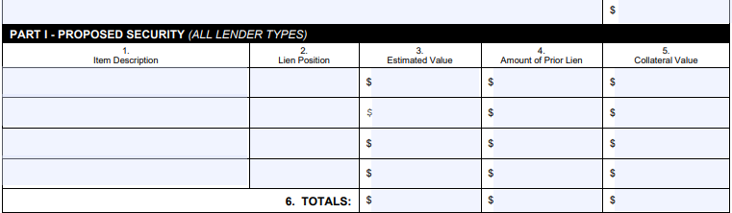
Application
Be descriptive
Source of truth
Should match the narrative

Slide 6

Narrative Documentation
SEL/CLP
  Our standard lending practice for a non-guaranteed loan requires _________________ to adequately secure the loan. The proposed application’s collateral for the guaranteed loan request is secured by ________________ and meets/exceeds or internal lending practices for loan security.
PLP
  ABC Bank certifies the proposed collateral meets our collateral standards set forth in our approved Credit Management System (CMS).

Slide 7

Loan to Value Calculation
LTV is standardized for all requests with one formula:
LTV = (Guaranteed loan amount + prior liens)
        Market value
*For lines of credit, the loan ceiling/credit limit must be used when calculating the LTV

Slide 8
Limiting additional security
Loan Request: $1,000,000
Proposed Security: 1st lien on 119 acres $1,000,000
2nd lien on 351 acres with $1,626,691 in remaining collateral value
Can there be a separate mortgage on the 351 acres limited to $500,000?
No, all security must secure the entire loan or line of credit. Lender cannot take separate security for the unguaranteed portion.
Notes:
Response:
According to [7 CFR 762.126(b)(1)] All security must secure the entire loan or line of credit. The lender may not take separate security to secure only that portion of the loan or line of credit not covered by the guarantee.
By limiting the second mortgage to a dollar amount, they are in effect limiting the security to only a portion of the loan rather than the entire loan.
Therefore we agree lender is unable to limit the second mortgage to $500,000. They would be required to take a full 2nd position on the real estate.

Slide 9
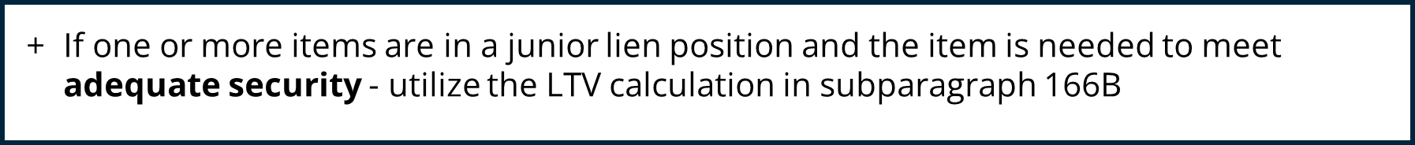
85% Rule/Junior Liens
Junior lien positions are acceptable only if total amount of debt with liens on the security including the debt in junior lien position is less than or equal to 85% of the value of security
When do I need to use the 85% LTV rule?
?

Slide 10
Junior/Shared Lien Position
WHEN the loan request is a…. | THEN the lien position
Subsequent Guaranteed Loan Same lender Same collateral Not junior to unguaranteed loan | Equal lien to original guaranteed loan
Subsequent Guaranteed loan and is junior to an unguaranteed loan | Junior lien position
Subsequent Non-Guaranteed loan and has the same or different lender | Junior lien position to the guaranteed loan
Guaranteed Loan and Non-Guaranteed loan Same lender Same collateral Close at the same time or guarantee comes after | Shared lien position Lender makes the shared lien determination
Non-Guaranteed Loan made after a guarantee | Junior lien position to the guaranteed loan

Slide 11
Shared Lien Position
Conditional Commitment Language
This guaranteed FO loan in the amount of $_______is to be closed simultaneously with
an unguaranteed loan in the amount of $________. These loans will equally share first lien
position on approximately ____ acres of real estate along with leases and improvements.
In the event the security is liquidated, the proceeds will be divided pro rata based on the
above loan amounts totaling $_____________. If liquidation occurs ___% of the proceeds
would be applied onto the guaranteed loan and ____% of the proceeds would be applied
onto the unguaranteed loan.

Slide 12
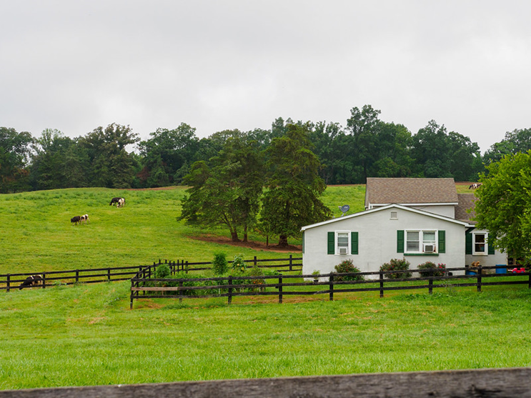
Appraisals
Real Estate: <$250,000 internal evaluation
>$250,000 Certified General Appraisal
18 months or less from date application
Personal Property: Internal evaluation
12 months or less from the date of application
Additional Security: Valuation acceptable
*Not required as a part of a complete application
Notes:
Response:
According to [7 CFR 762.126(b)(1)] All security must secure the entire loan or line of credit. The lender may not take separate security to secure only that portion of the loan or line of credit not covered by the guarantee.
By limiting the second mortgage to a dollar amount, they are in effect limiting the security to only a portion of the loan rather than the entire loan.
Therefore we agree lender is unable to limit the second mortgage to $500,000. They would be required to take a full 2nd position on the real estate.

Slide 13

Reminders
FSA guarantees are not a substitution for collateral. Make sure loans are adequately secured.
Junior liens may prompt conversations on security
FSA guaranteed collateral determinations need to be treated the same as non-guaranteed loans
Collateral section of the application and the narrative will need to be completed
Conditional commitments will include language on potential reduction in loss claims if discovered the collateral was treated differently than non-guaranteed loans.
Notes:
Response:
According to [7 CFR 762.126(b)(1)] All security must secure the entire loan or line of credit. The lender may not take separate security to secure only that portion of the loan or line of credit not covered by the guarantee.
By limiting the second mortgage to a dollar amount, they are in effect limiting the security to only a portion of the loan rather than the entire loan.
Therefore we agree lender is unable to limit the second mortgage to $500,000. They would be required to take a full 2nd position on the real estate.

Slide 14
Guaranteed Loan Servicing

Slide 15

2-FLP Sub Par. 262A
Servicing Guaranteed Collateral
Lender Servicing Requirements (7 CFR 762.142(a))
    Obtaining, and maintaining, assignments
    Inspecting collateral as often as deemed necessary to properly service the loan
    Ensure collateral is not being converted
    Proceeds from collateral are accounted for and applied in lien priority
    Protecting collateral during bankruptcy, foreclosure, or other legal issues
    Making sure taxes, assessments, and rents are paid
    Obtaining, and maintaining, adequate insurance

Slide 16

Servicing Guaranteed Collateral (continued)
  Conditional Commitments contain specific collateral requirements. Review and make sure these are followed
  FSA may highlight potential collateral risks during lender file reviews. Major deficiencies are documented in a letter to the lender and require a corrective action plan
  Lenders must ensure subordinations are completed in accordance with 7 CFR 762.142 and 2-FLP paragraph 278
  Lenders must ensure partial releases are completed in accordance with 7 CFR 762.142(b) and 2-FLP paragraph 280

Slide 17
Examples of Loss Claim Issues Related to Collateral
All security is not accounted for.
Sales of security are not adequately documented.
Proper or required lien position is not being obtained and/or maintained during the period of the guarantee.
Delays in liquidation process without justification or FSA concurrence.
Insurance coverage doesn’t reflect current market value of collateral
Notes:
2 brief examples: Had a loss claim that lender used a 3rd party to do all inspections and appraisals. When it came to liquidation everything was junk. Stock trailer had a tree growing through the floor of it. Lender sold everything by seal bid. Made reductions as last appraisal from the previous year and loan making showed all equipment as in good condition. The regulations do not allow the Agency authorization to allow security to be sold by private treaty for less than appraised value. If an auction is held and items do not bring appraised value at the auction then that would be the established market value at that time.
Not running all proceeds through the guaranteed OL/LOC and using the guaranteed OL/LOC as authorized and approved for.

Slide 18
Lender Reviews

Slide 19
Changes to Lender Review Process
Routine lender reviews will be conducted on a less frequent schedule
    Agency officials retain the ability to conduct lender reviews more frequently when necessary to ensure adequate management of guaranteed loan portfolio
    For SEL and MLP Lenders:
FSA will review 20 percent of the lender’s outstanding guaranteed borrowers every three years
    For CLP and PLP Lenders:
FSA will review 20 percent of the lender’s outstanding guaranteed loan borrowers, up to a maximum of 50 borrowers, every five years.

Slide 20
Streamlined Guaranteed Estimated Loss Claims
Notes:
Bob

Slide 21
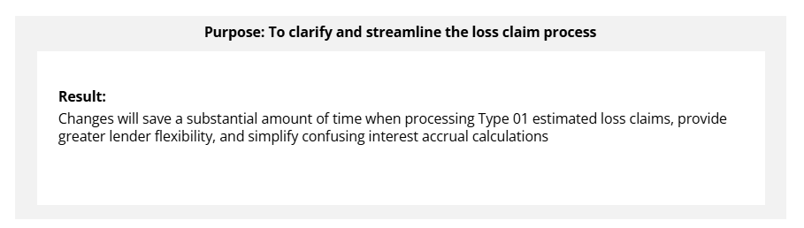
Streamlined Guaranteed Estimated Loss Claim
Most notable changes:
Type 01 estimated loss claims will not require documentation, except for loan ledger, for all lender types
Interest on the Type 01 estimated loss claim will never exceed 210 calendar days

Slide 22
Semi-Annual and Default Status Reports
Notes:
Kim B
Introduce self and topic

Slide 23
FSA-2241 Status Report Changes
FSA-2241 Guaranteed Farm Loan Status Report must be submitted as of March 31 and September 30 every year to provide FSA an update all on loans within a lender’s guaranteed portfolio.
Beginning with September 30, 2025 reports, FSA will no longer be sending partially filled hard copy reports to lenders for completion.
Lenders have a few options for completing reports
  Utilize the Lender’s Interactive Networking Connection (LINC) to complete updates online
  Download and complete FSA-2241 using the form found online or emailed to you by your local FSA Staff

Slide 24
Default Status Report Reminders
FSA-2248 Guaranteed Farm Loan Default Status Report is due when a loan is 30 days past due and every 60 days thereafter, until default is cured or a Final Loss Claim is paid.
Lenders should provide details of actions taken in the comments section
Upon loan acceleration, submit a copy of the acceleration letter with FSA-2248
The FSA-2241's and the FSA-2248's submitted following acceleration will all reflect the entire loan balance as past due

Slide 25
Online Electronic Transaction Options
Notes:
Kim B
Introduce self and topic

Slide 26
LINC
LINC (Lender Interactive Network Connect) provides Guaranteed Lenders the ability to conduct business with FSA online.
Enter Loan Closings
Submit Electronic Fee Payments
Submit Semi-Annual Status Reports
Submit Default Status Reports
View specific Loan Information
Establish Lender Pre-Authorized Debit (PAD)

Slide 27
Why sign-up for LINC?
Eliminates paper/mail transactions of semi-annual status and default status reports; paper reports will no longer be mailed.
Saves time by allowing lender to enter status in LINC.
Can manage status reports with one or more representatives from your lending institution.

Slide 28
LINC (continued)
The LINC User Guide provides step by step instructions for lenders in completing the functions just discussed.
  LINC User Guide
Quick Reference Guide for LINC gives lenders helpful tips on how to set up and use the LINC system.
  Quick Ref Guide for LINC
Quick Reference Guide for Level 2 eAuth Account will assist lenders in setting up their level 2 eAuth account that will allow them to access and use the LINC system.
  Quick Ref Guide for Level 2 eAuth

Slide 29
Troubleshooting LINC
First confirm if you have Level 2 eAuth access
After gaining Level 2 eAuth access, FSA will need your email address (Level 2 euth ID), phone number, bank name, and branch(s) you plan to submit status reports for
Contact your local FSA Service Center for any questions or issues with LINC
Quick Reference Guide available on the website

Slide 30
This concludes the live event.
Thank you for your attention.

