Slide 1
2019 County Committee Elections
Notes:
GO TO VIEW > MASTER > SLIDE MASTER TO EDIT THE IMAGES ON THE TITLE AND DIVIDER SLIDES

Slide 2
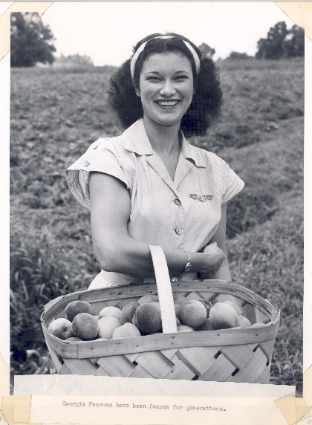
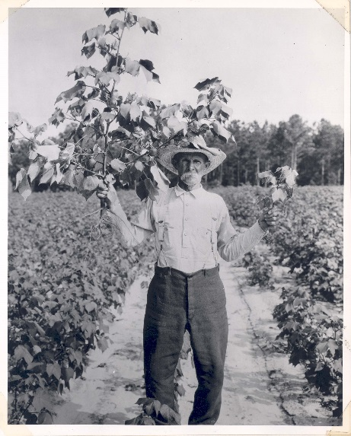
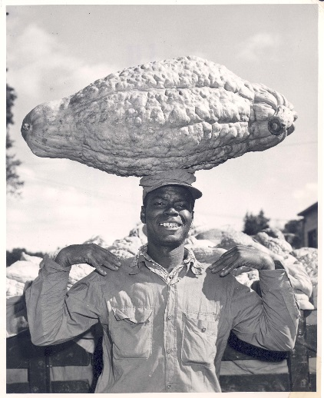
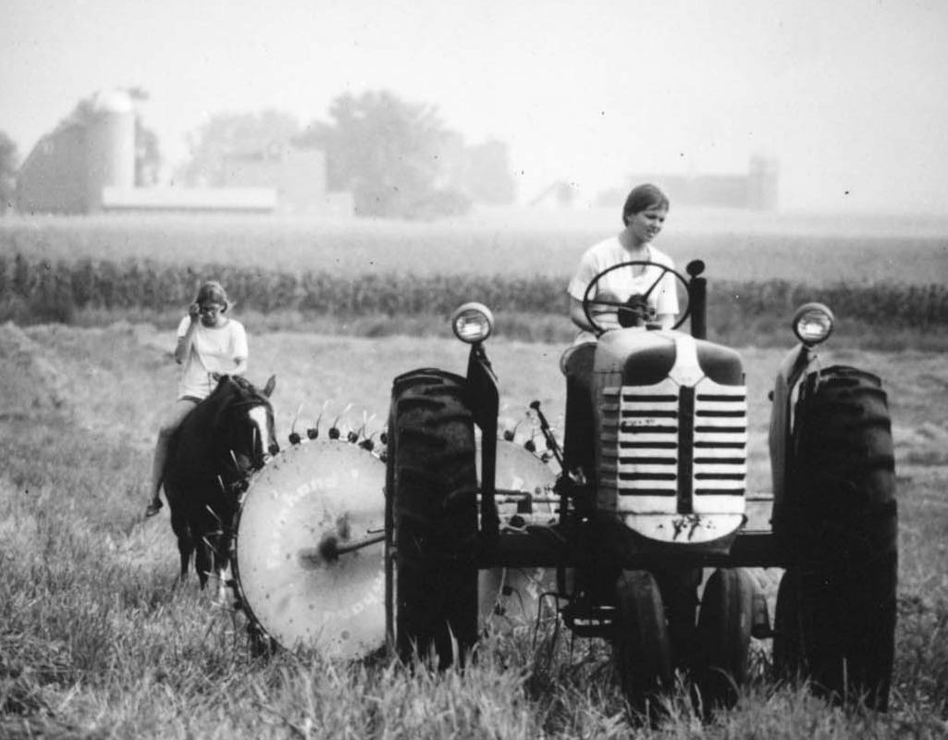
What is a County Committee?
Authorized by Congress in 1930s.
Critical component of the day-to-day operations of FSA.
More than 7,700 committee members serve on more than 2,200 committees nationwide.
Notes:
The County Committees were originally authorized by Congress in the 1930s, to allow grassroots input and local administration of programs.
County Committees are a critical component of the day-to-day operations of FSA. Members vote to come to consensus on various items including yield determination for the county, the County Executive Director (CED) ratings and hiring, and approving producer applications when required for various Farm Programs.
More than 7,700 committee members serve on more than 2,200 committees nationwide.
Source: https://www.fsa.usda.gov/Internet/FSA_Federal_Notices/countycomm_2012.pdf
Photo source: https://www.flickr.com/photos/usdagov/3926150681/in/dateposted/ (woman with peaches)
Photo source: https://www.flickr.com/photos/usdagov/3926150809/in/dateposted/ (man with fruit on head)
Photo source: https://www.flickr.com/photos/usdagov/3926150761/in/dateposted/ (man holding up plants)
Photo source: https://www.flickr.com/photos/usdagov/3926156113/in/photostream/ (women in field on tractor and horse)

Slide 3
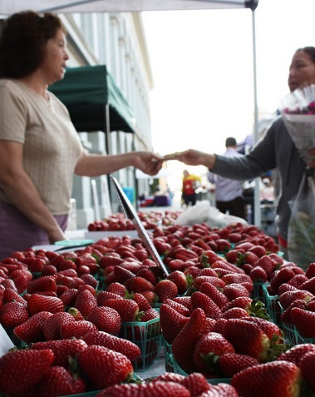
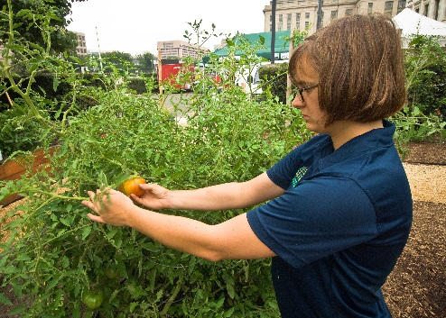
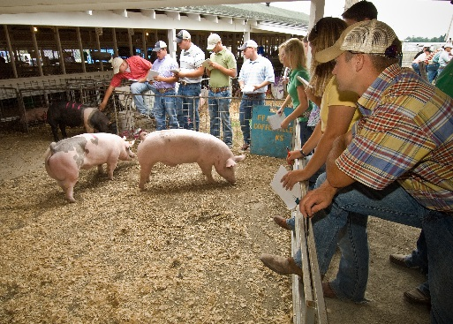
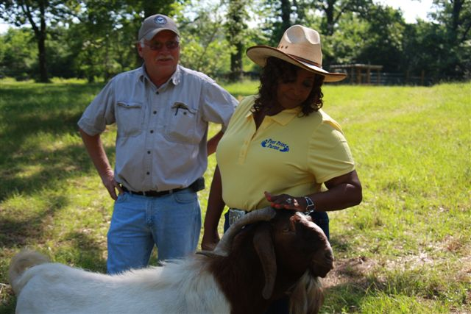
Role of County Committee Members
Help area farmers, ranchers and foresters.
Deliver federal programs locally.
Notes:
Photo source: https://www.flickr.com/photos/usdagov/3865900196/in/dateposted/ (woman checking tomato)
Photo source: https://www.flickr.com/photos/usdagov/3903034113/in/dateposted/ (people watching pigs)
Photo source: https://www.flickr.com/photos/usdagov/6033120954/in/dateposted/ (buying at market)
Photo source: https://www.flickr.com/photos/usdagov/6053939250/in/dateposted/ (farmer with goat)

Slide 4
Why Are County Committees Important?
Make Decisions on:
  Price support loans & payments
  Acreage verification
  Conservation programs
  Incentive, indemnity & disaster payments
  Payment eligibility

Slide 5
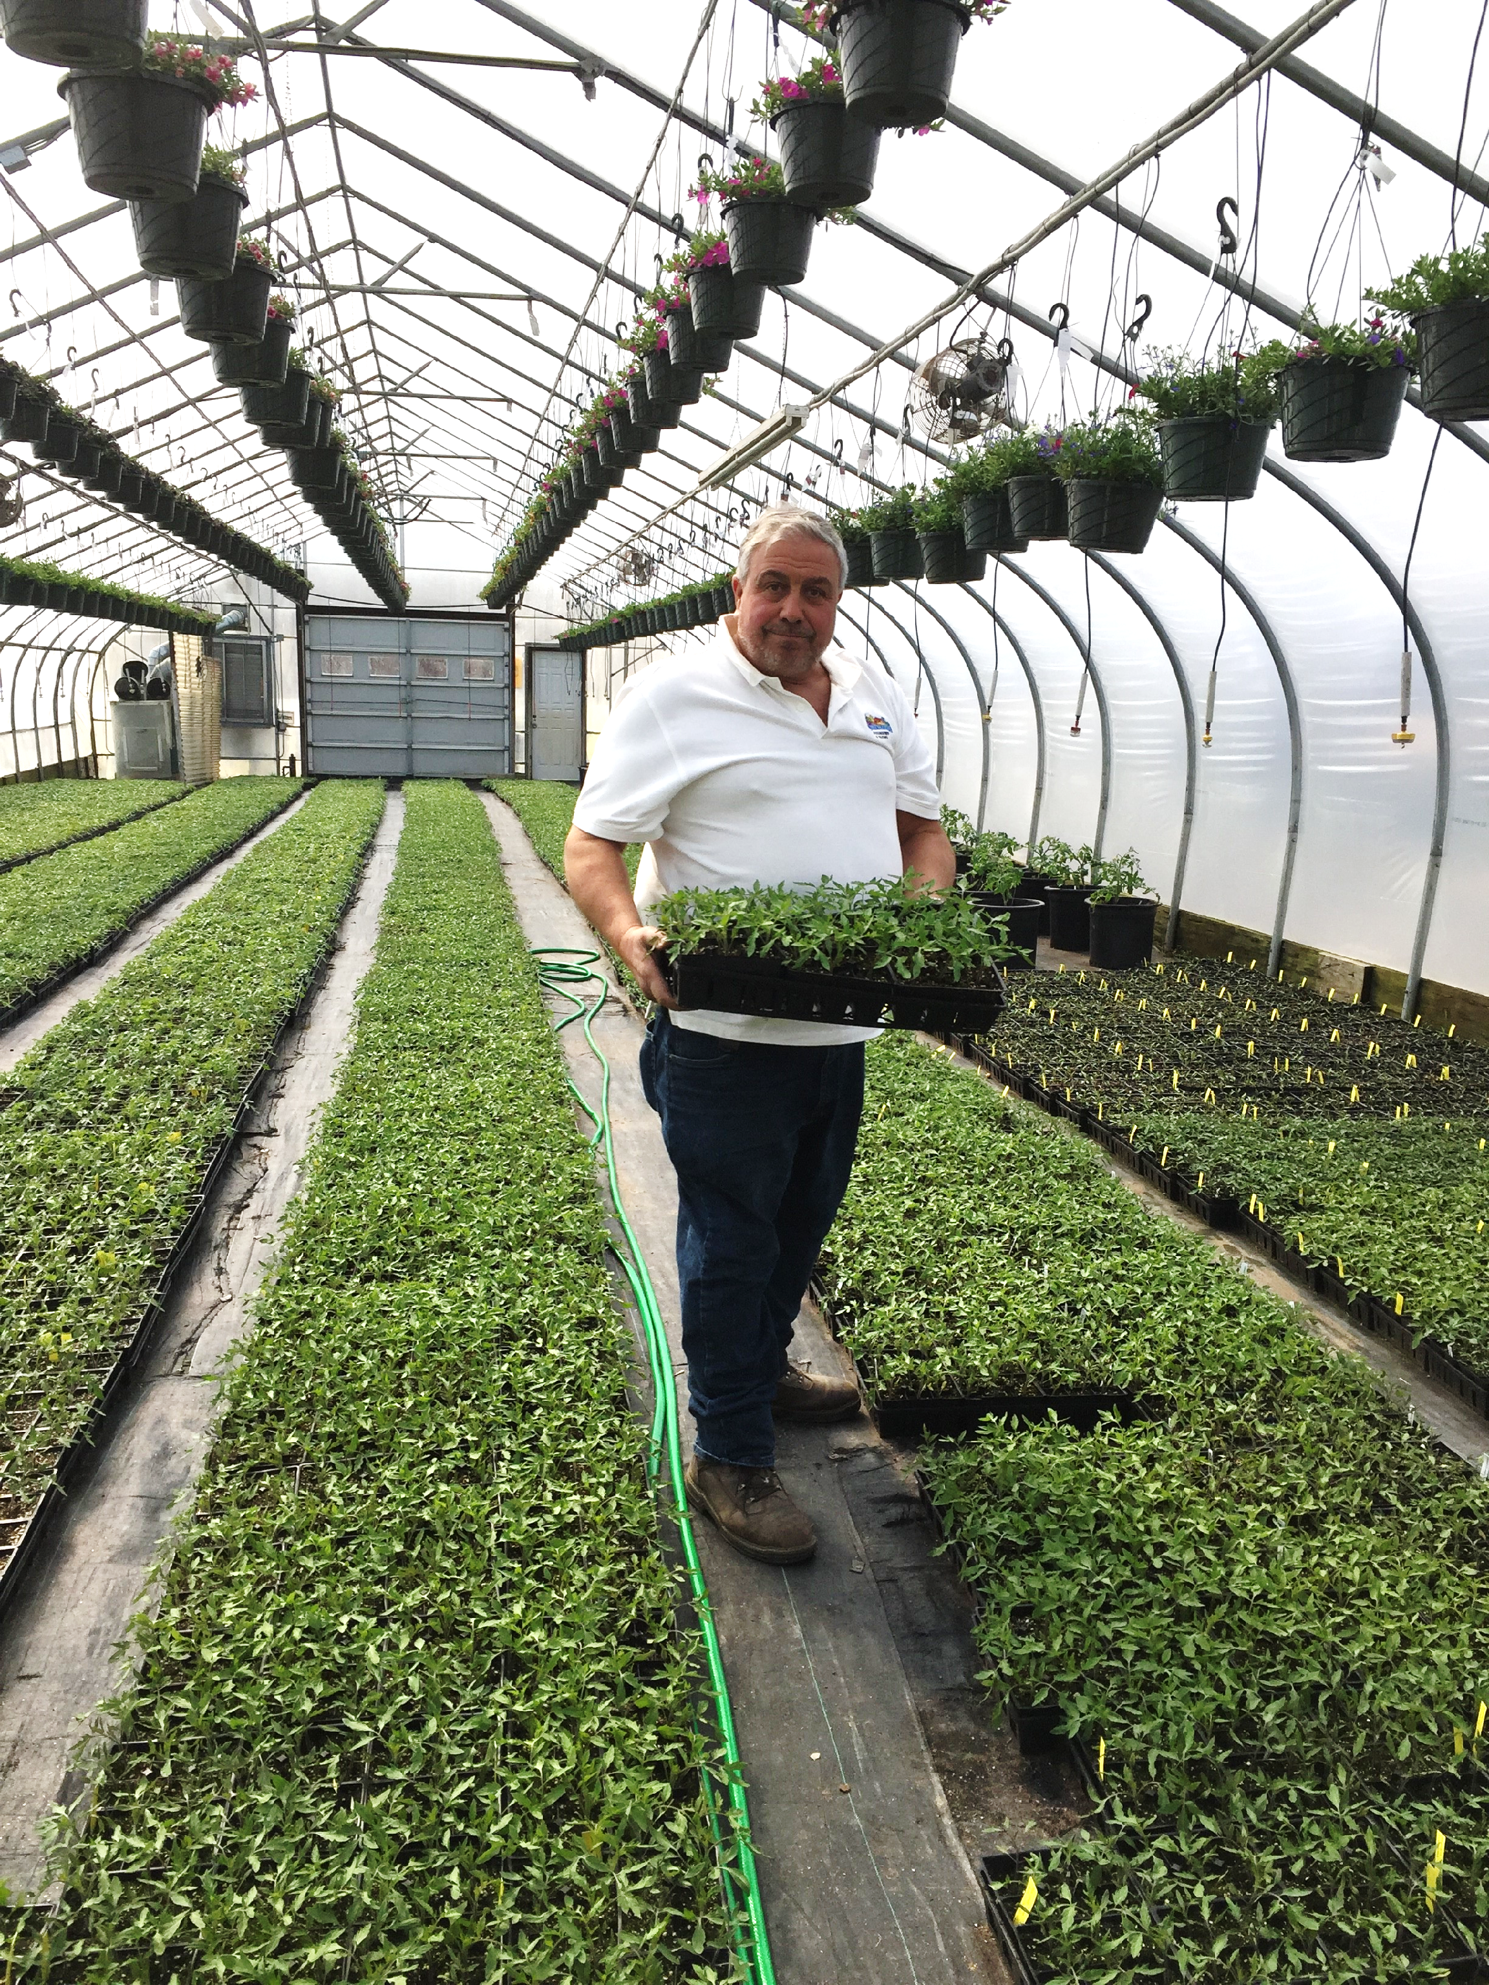
Duties of the County Committee
Inform farmers of the purpose and provisions of FSA programs.
Keep the State FSA Committee informed of local administrative area (LAA) conditions.
Monitor changes in farm programs.
Notes:
Photo: Vincent J. Confreda, a member of the Kent County, Rhode Island, Farm Service Agency (FSA) County Committee, is part of Confreda Farms, one of the oldest and largest commercial vegetable farms in Rhode Island. Courtesy of Rhode Island FSA.

Slide 6
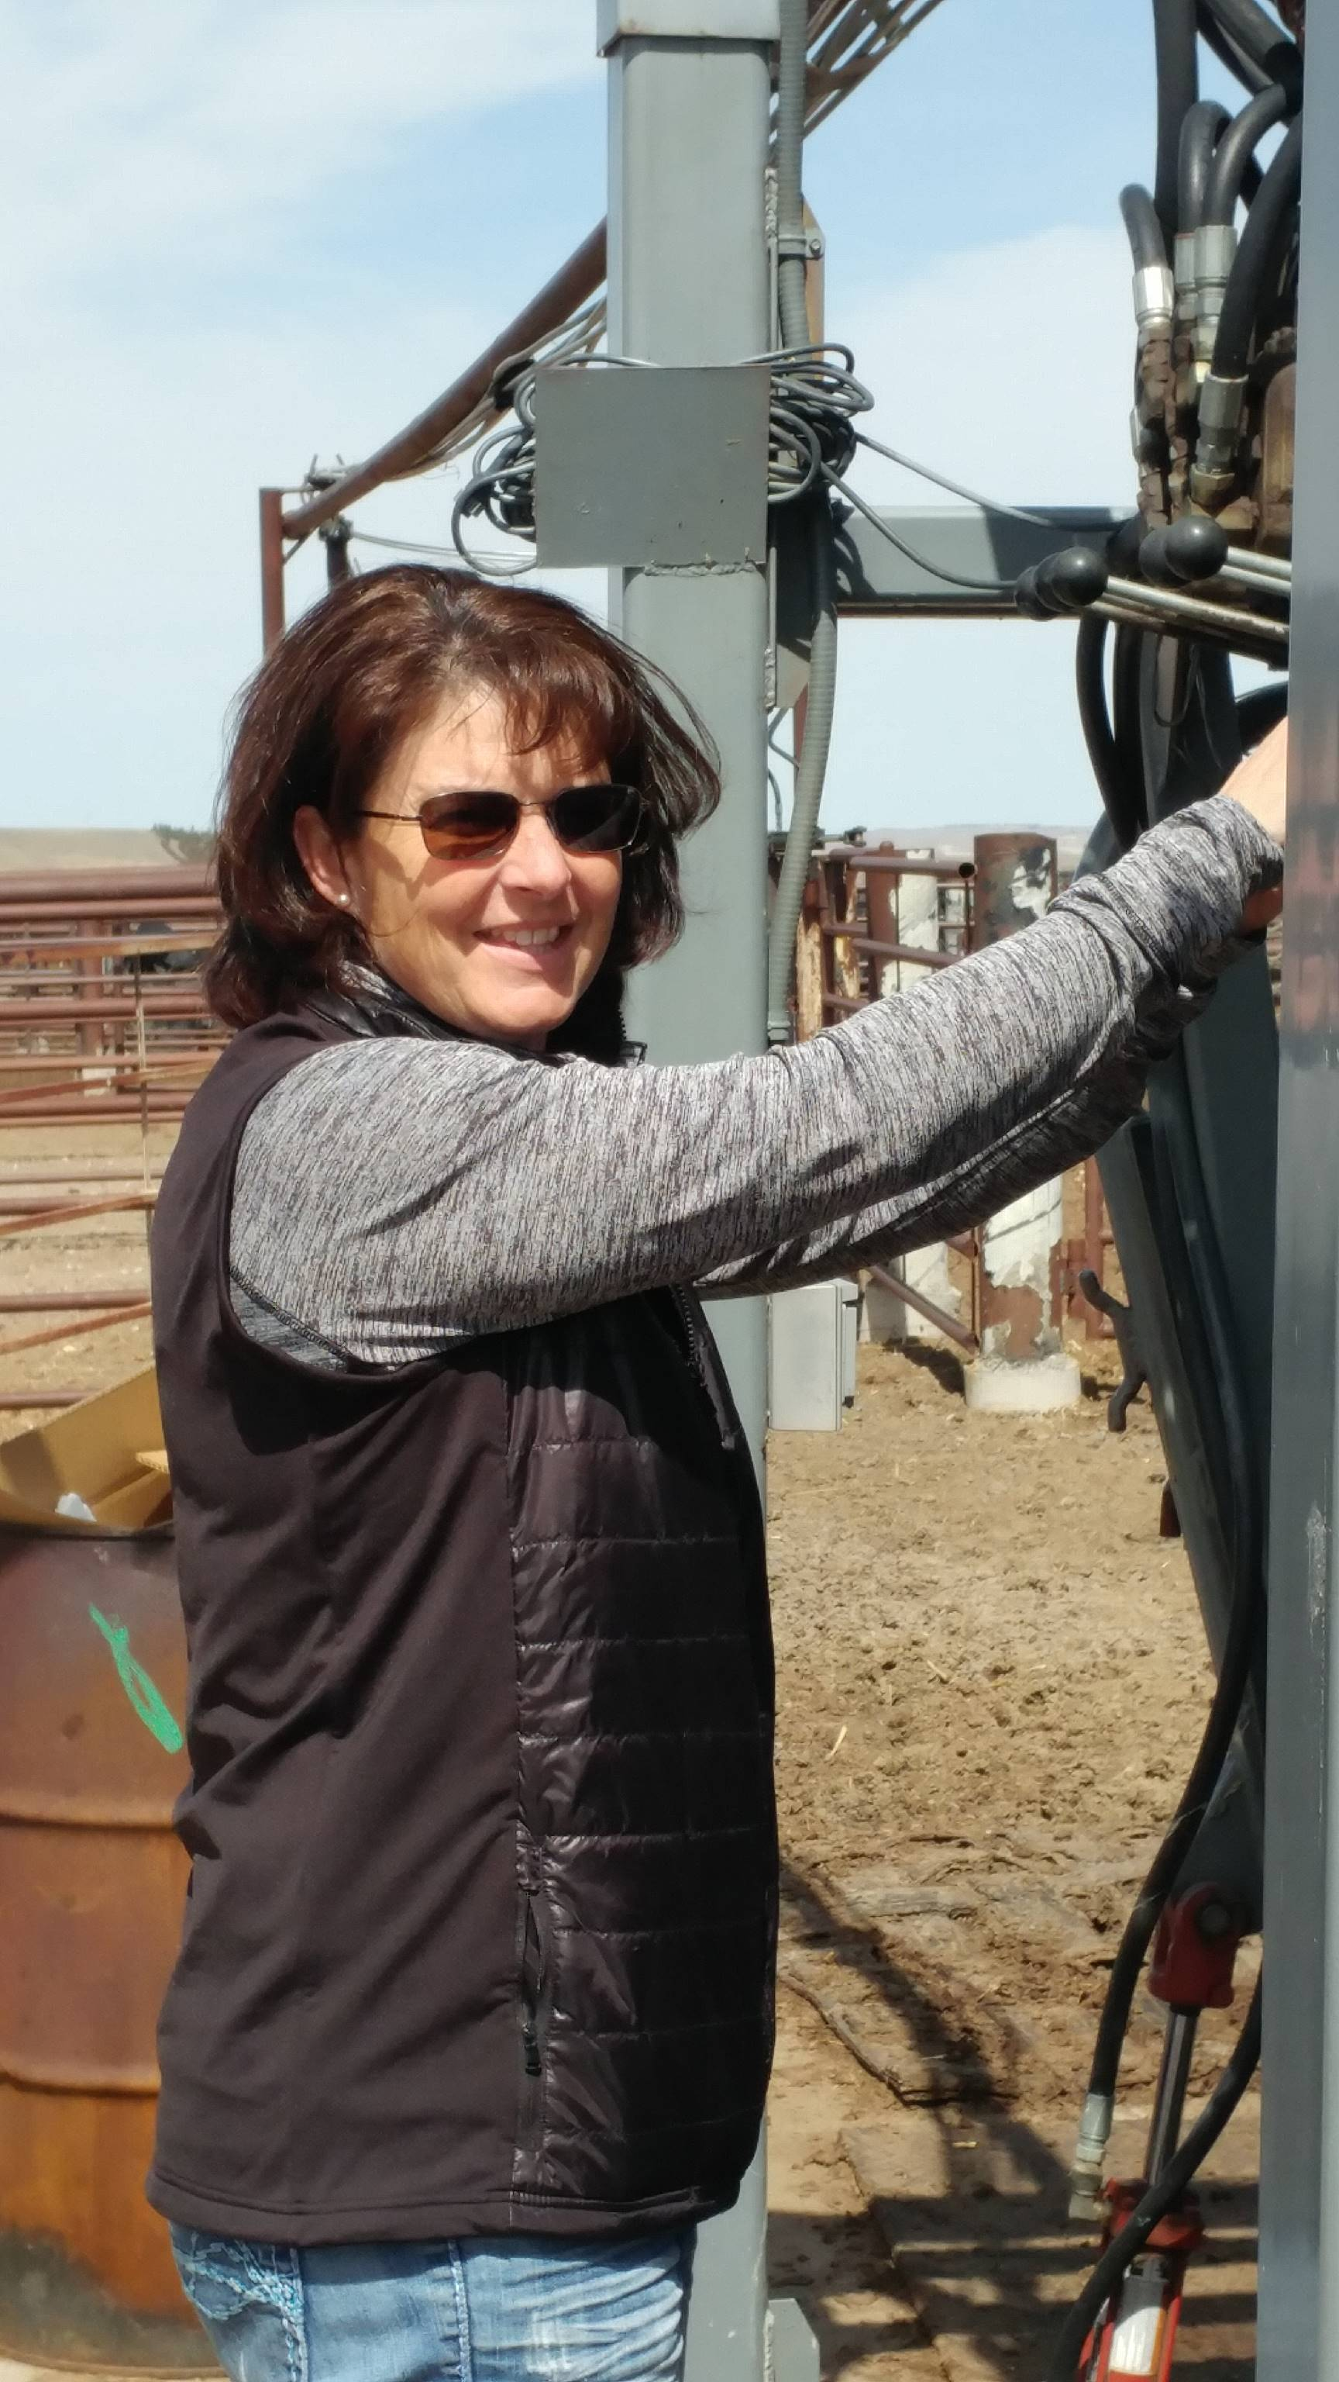
Duties of the County Committee Continued…
Participate in monthly meetings.
Make recommendations to State Committee on existing programs.
Ensure underserved farmers and ranchers are fairly represented.
Notes:
Photo: Amy Miller of Wheatland, Wyoming, returned to her family’s ranch after receiving a degree in accounting from the University of Wyoming and spending time in Arizona as a loan officer. She uses her business skills to handle the bookwork for the ranch. She also serves on the Platte County FSA Committee. Photo courtesy of Amy Miller.

Slide 7
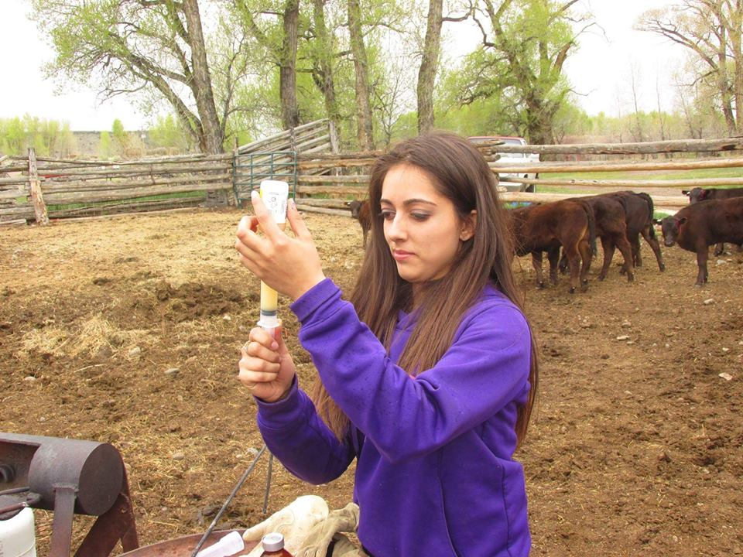
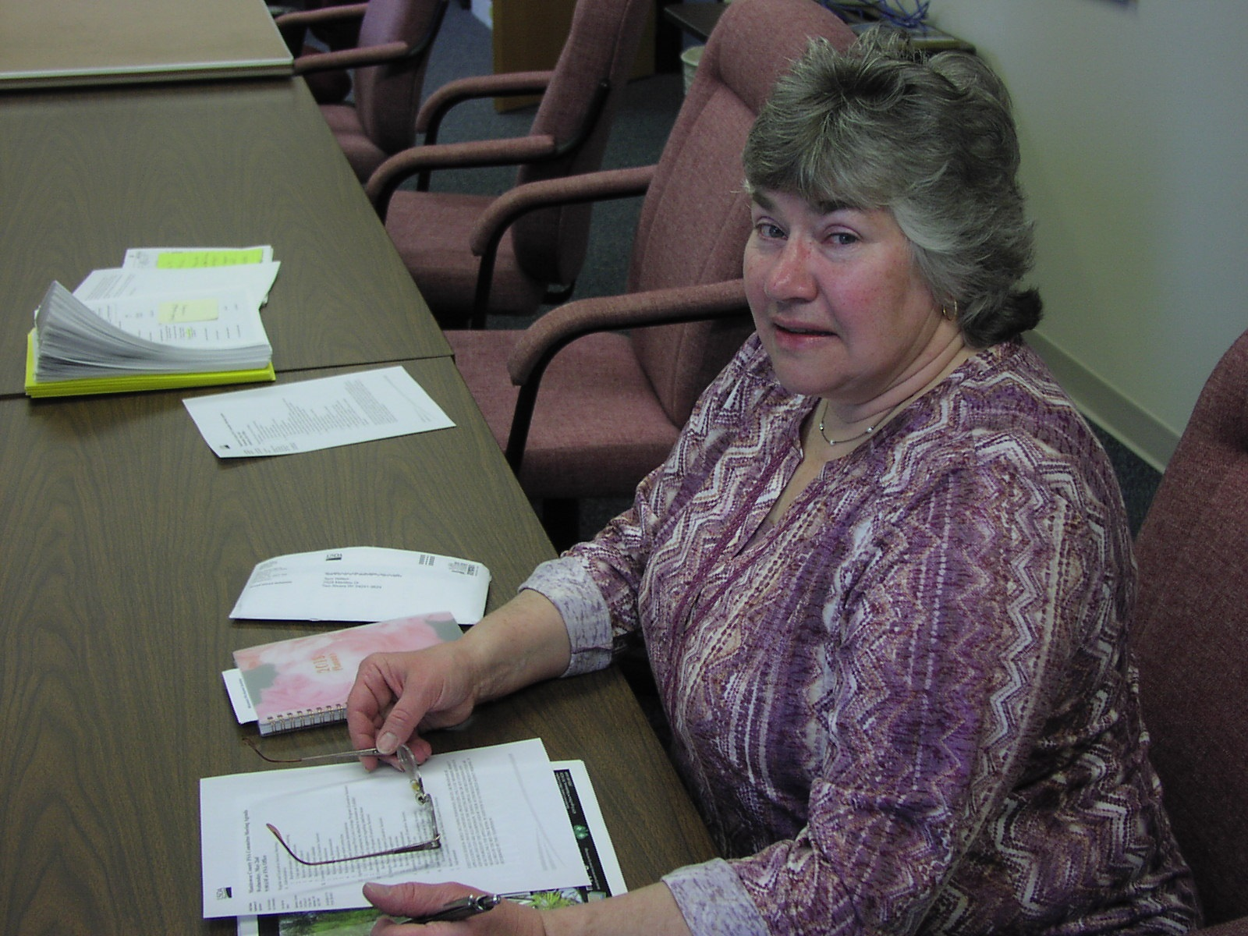
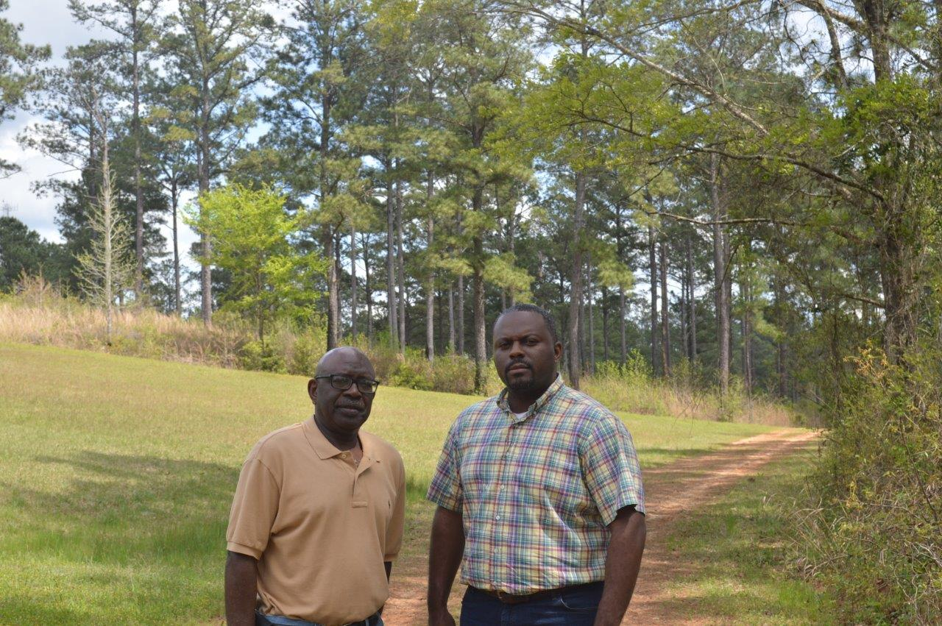
Get Involved
USDA encourages all eligible farmers, ranchers and foresters to participate in the county committee election process.
Notes:
Photos: Left to Right:
Willie Scott Smith (left), member of the Greene County FSA Committee in Alabama, shows his pine tree operation to Alex Crawford (right), county executive director of the Greene and Sumter County FSA offices. Photo courtesy of Alabama FSA.
Terri Wilfert, a member of the Manitowac County, Wisconsin, Farm Service Agency Committee, and her husband, David, produce a variety of row crops, as well as carrots for processing and a variety of fresh market vegetables. Photo courtesy of Wisconsin FSA.
Maintaining the health and well-being of the cattle herd is one of roles fifth-generation farmer Miranda Sandoval fulfills on her family ranch. Sandoval is a member of the Conejos County FSA Committee. Photo courtesy of Miranda Sandoval.

Slide 8
Who Serves on County Committees?
To hold office as a COC member or alternate, a person must fulfill each requirement:
  Be a producer with an interest in farming or ranching operations
  Participate or cooperate in any FSA program provided for by law
  Be a U.S. Citizen
  Be of legal voting age
  Meet the basic eligibility requirements
  Reside in the county or multi-county jurisdiction in which they will be serving.
Notes:
Agricultural producers who participate or cooperate in an FSA program may be nominated for candidacy for the county committee. Individuals may nominate themselves or others as a candidate. Additionally, organizations representing underserved (minority and women) farmers or ranchers may nominate candidates. Nomination forms are filed for the county committee of the office that administers a producers’ farm records.
To become a nominee, eligible individuals must sign nomination form FSA-669A. The form includes a statement that the nominee agrees to serve if elected. This form is available at the FSA county office and online at www.fsa.usda.gov/elections.
Nomination forms for the 2019 election must be postmarked or received in the local FSA county office by August 1, 2019.

Slide 9
Committee Basics
3 to 11 Members
3-year Terms
Advisors appointed annually to represent women and minority interests

Slide 10
Role of the Advisor
Officially appointed by the FSA state committee based on county committee or community-based organizations recommendations.
Appointed to county committees in counties or multi-county jurisdictions that have significant numbers of underserved producers, but lack such members on FSA county committee.
Provide diverse viewpoints and represent the interests of underserved communities in the decisions made by the County Committee.
*Non-voting position
Notes:
This is a non-voting position.

Slide 11
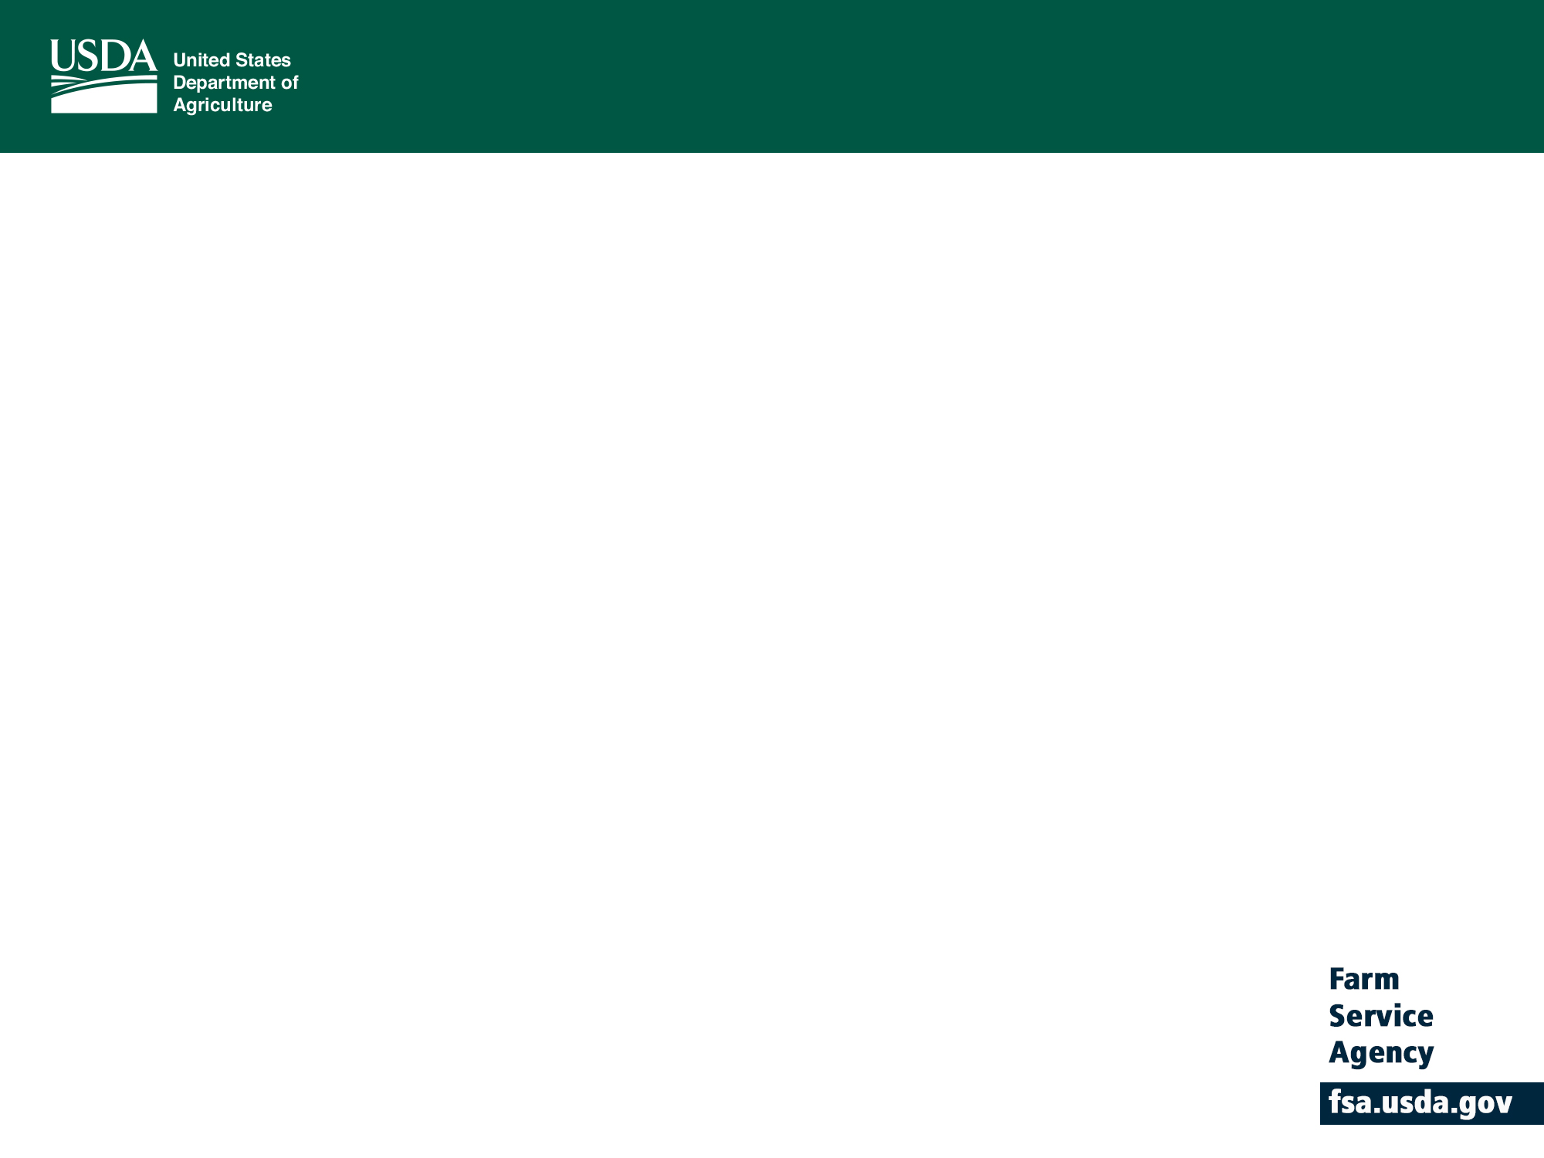
How are Advisors Appointed?
  The Non-Voting Advisors get selected by the State County Committee after the County Committee sends up recommendations.
  A Voting SDA Advisor is appointed by the Secretary after USDA runs a report to see which county needs an appointed SDA after the regular election.

Slide 12
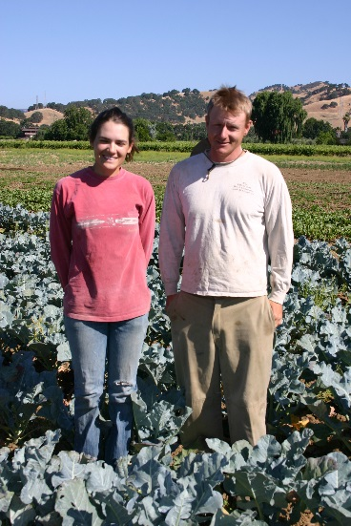
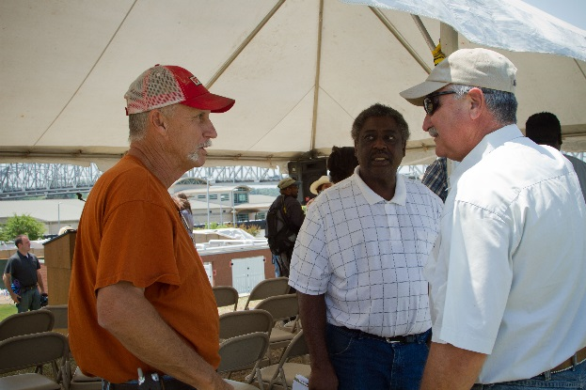
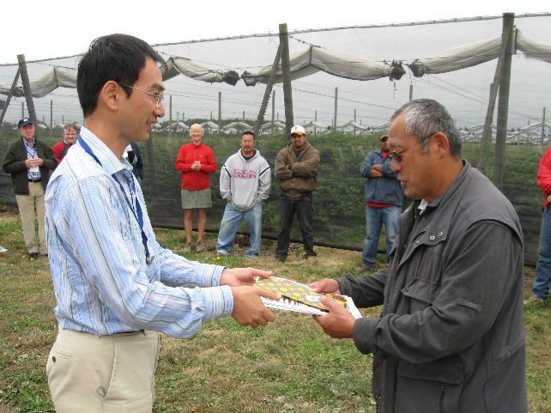
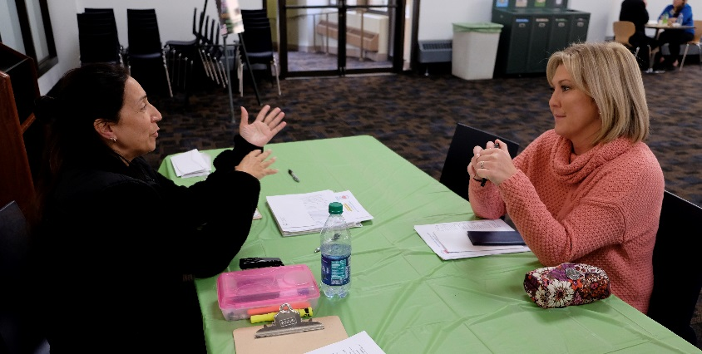
How do I participate in the County Committee elections?
Nominate
Vote
Inform others
Notes:
Photo source: https://www.flickr.com/photos/usdagov/4863432063/in/dateposted/ (couple)
Photo source: https://www.flickr.com/photos/usdagov/5746850679/in/dateposted/ (informing others)
Photo source: https://www.flickr.com/photos/usdagov/6144162527/in/dateposted/ (handing forms)
Photo source: https://www.flickr.com/photos/usdagov/29971665344/in/dateposted/ (women at table)

Slide 13
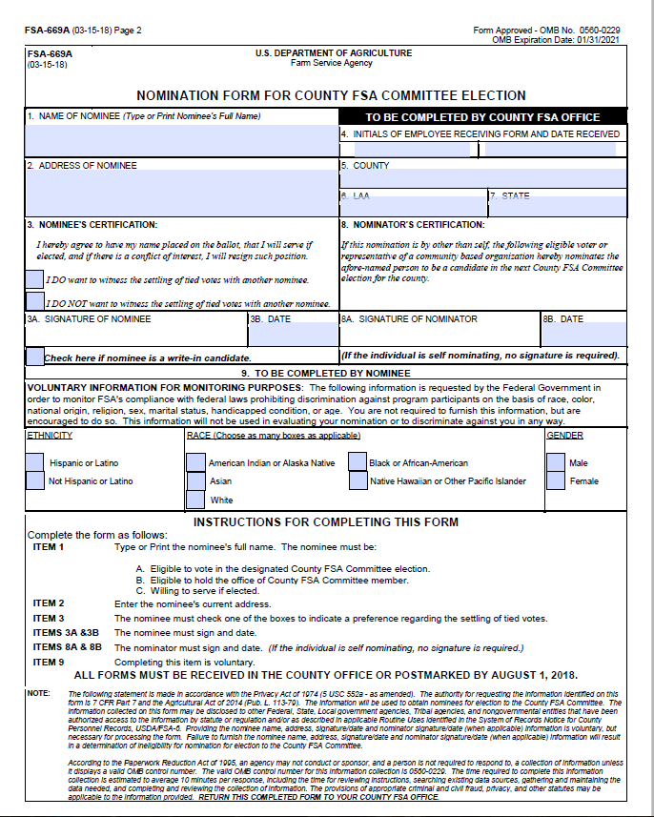
Nominating
Runs June 14 – August 1
Nominate yourself or others
Forms available online at
www.fsa.usda.gov/elections or from any FSA office
Must sign form

Slide 14
How to Nominate
  To hold office as a COC member or alternate, a person must fulfill each requirement:
    be a producer who owns or operates a farm or ranch;
    participate or cooperate in any FSA program provided for by law;
    be a U.S. Citizen;
    be of legal voting age;
    meet the basic eligibility requirements; and
    reside in the county or multi-county jurisdiction in which they will be serving.

Slide 15
How to Nominate, continued
  Individuals may nominate themselves or others as a candidate.
  Additionally, organizations representing underserved (minority and women) farmers or ranchers may nominate candidates.
  Nomination forms are filed for the county committee at the office that administers a producer’s farm records.

Slide 16
How to Nominate, continued
  To become a nominee, eligible individuals must sign nomination form FSA-669A.
  The form includes a statement that the nominee agrees to serve if elected.
  This form is available at your FSA county office and online at www.fsa.usda.gov/elections.

Slide 17
Who can Vote?
Be of legal voting age and have an interest in a farm or ranch as either:
  An individual who meets one or more of the following:
    Is eligible to vote in one’s own right
    Is a partner of a general partnership
    Is a member of a joint venture
Notes:
A person who meets the requirements in number 1 or number 2, as well as number 3, is eligible to vote in the 2019 county committee elections.

Slide 18
Who can Vote? Continued…
Be of legal voting age and have an interest in a farm or ranch as either:
  A non-individual who is the authorized representative of a legal entity, such as:
    A corporation, estate, trust, limited partnership or other business enterprise, excluding general partnership and joint ventures
    A state, political subdivision of a state or any state agency. (only the designated representative may cast a vote for the entity)
Notes:
A person who meets the requirements in number 1 or number 2, as well as number 3, is eligible to vote in the 2019 county committee elections.

Slide 19
Who can Vote? Continued…
    OR
Not of legal voting age, but supervises and conducts the farming operations of an entire farm.
AND
Participates or cooperates in an FSA program that is provided by law.
Notes:
A person who meets the requirements in number 1 or number 2, as well as number 3, is eligible to vote in the 2019 county committee elections.

Slide 20
County Committee Elections
2019 Timeline
June 14, 2019 - Nomination period begins. Request nomination forms from any local USDA Service Center or obtain online at www.fsa.usda.gov/elections.
Aug. 1, 2019 - Last day to file nomination forms at the local USDA Service Center.

Slide 21
County Committee Elections
2019 Timeline
Nov. 4, 2019 – Ballots mailed to eligible voters.
Dec. 2, 2019 – Last day to return voted ballots to the USDA Service Center.
Jan. 1, 2020 - Newly elected county committee members take office.

Slide 22
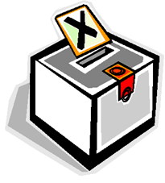
Voting
Period runs Nov. 4 – Dec. 2, 2019
Voters cast 1 vote per county office jurisdiction

Slide 23
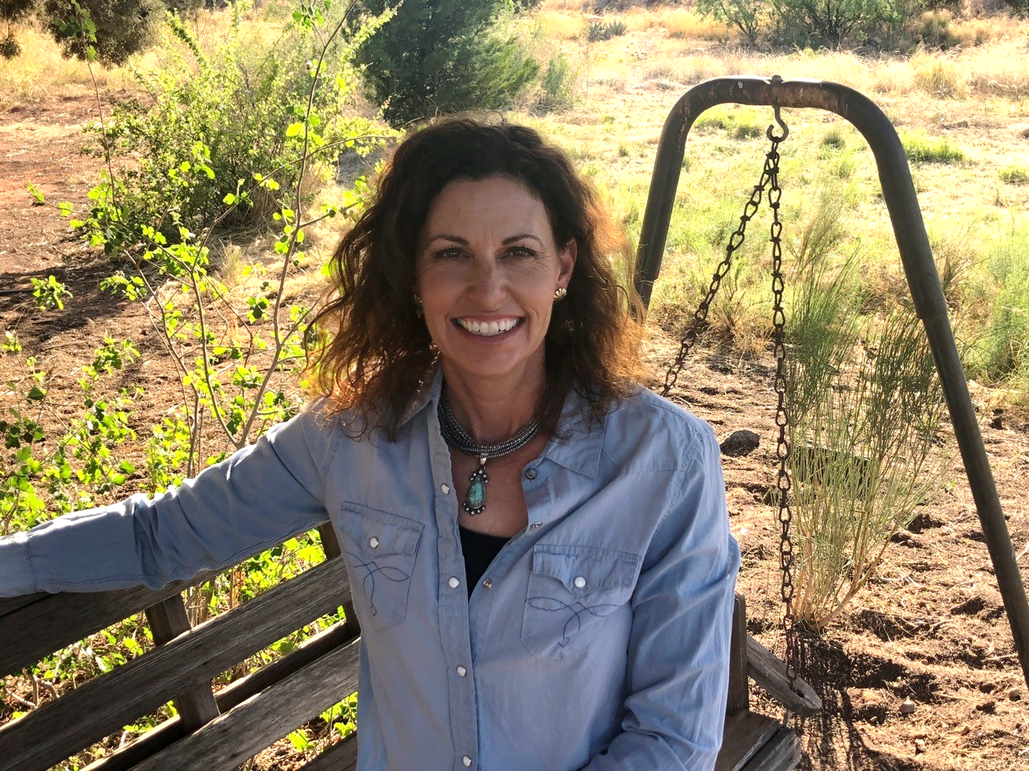
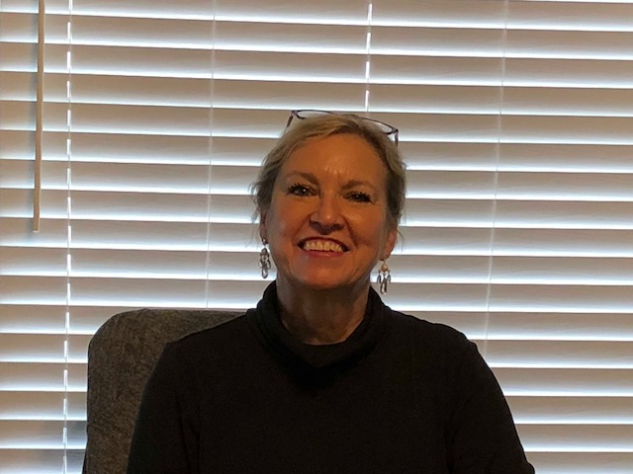
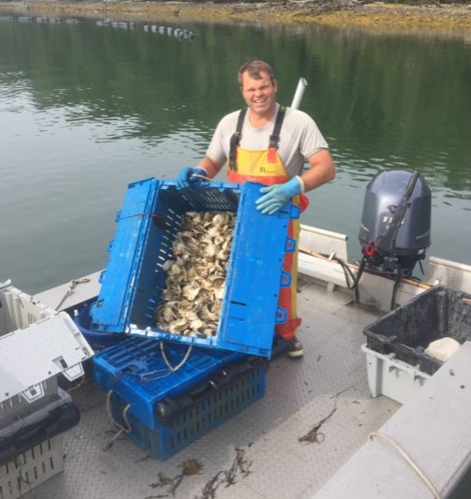
Where Can I Get More Information?
Visit your local FSA office
or visit:
www.fsa.usda.gov/elections
Notes:
Photos (left to right).
Farming and ranching is a family business for the Ross family of Arizona. Becki Ross and her family live on a cattle ranch and she currently serves on the Maricopa County FSA Committee. Photo courtesy of Becki Ross.
David Cheney of Lincoln County, Maine, owns and operates Johns River Oysters. He scuba dive harvests his American cocktail oysters year-round. Cheney serves on his local FSA county committee. Photo courtesy of David Cheney.
Debbie Bell has a history of involvement with her local Farm Service Agency (FSA) county committee. She is served her third year of her second term on the Stoddard County FSA County Committee in Missouri. Photo courtesy of Debbie Bell.

