Slide 1
Be a Leader with Farm Service Agency County Committee Elections
Notes:
GO TO VIEW > MASTER > SLIDE MASTER TO EDIT THE IMAGES ON THE TITLE AND DIVIDER SLIDES

Slide 2
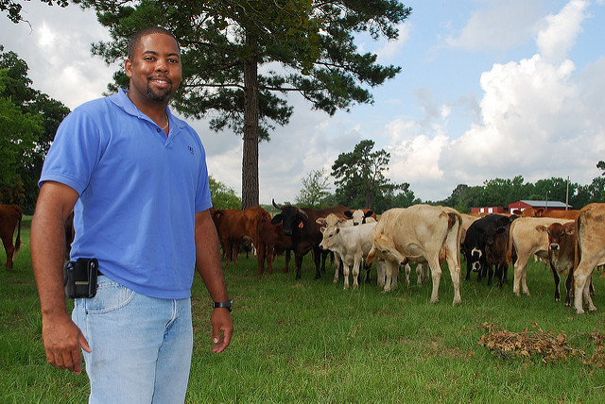
Your Voice Matters
FSA needs your help in making sure all farmers are represented and increasing the diversity of FSA county committees.
In 2017, approximately 81% of voting county committee members were male while women represented approximately 18% of voting members
In 2017, approximately 6.95% of elected voting county members were targeted underserved producers

Slide 3
Your County Committee Needs You!
If elected to serve, you can:
Organize and oversee FSA programs that make a difference for farmers and ranchers in your community;
Hire the county director that oversees daily FSA office operations; and
Make recommendations on programmatic and policy changes.
VOTE!
Represent your county
Support local candidates
Make your voice heard

Slide 4
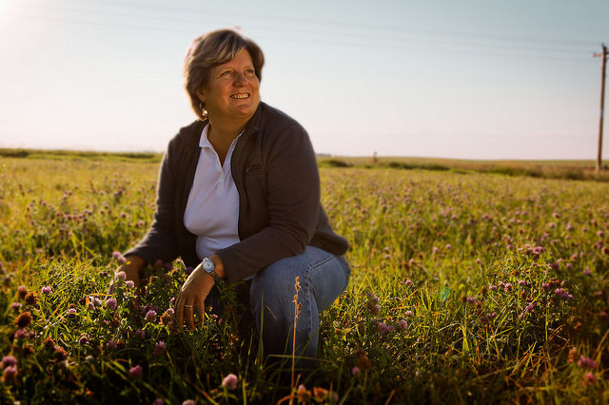
Be the Voice of Your Community
As an FSA county committee member, you will:
Deliver and administer farm programs in your community.
Represent local farmers and ranchers.
Provide local agricultural guidance and insight.
Make critical decisions impacting local producers.
Help share information about FSA opportunities within your community and focus outreach efforts to underserved producers and beginning farmers.

Slide 5
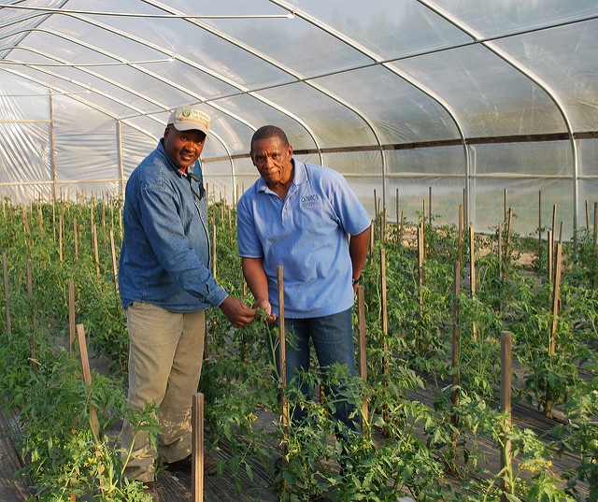
Lead…Serve…Give Back
More than 7,000 dedicated farmers and ranchers serve on FSA County Committees in rural areas.
FSA County Committees:
Informed decisions made by FSA service centers across the country that impact producers.
Represent the priorities and voice of producers in their community.
Ensure USDA’s farm programs continue to serve farmers, ranchers and families.

Slide 6
Commitment
Elected members serve three year terms and committees consist of three to 11 members.
County committees meet monthly to discuss critical decisions impacting local producers.

Slide 7
Eligibility
To be eligible a producer must:
Have an interest in farming or ranching operations;
Participate or cooperate in any FSA program provided for by law;
Be a U.S. Citizen;
Be of legal voting age;
Meet the basic eligibility requirements; and
Reside in the county or multi-county jurisdiction (LAA) in which they will be serving.
You must be in a LAA (Local Administrative Area) that has member openings during the election period.
Producers can learn more about eligibility by contacting their local office.

Slide 8
Don’t Delay…Nominate Today
Mark Your Calendars
Deadline for Nominations: Aug. 1, 2019
Election ballots mailed to eligible voters: Nov. 4, 2019
Newly elected members take office: Jan. 1, 2020
Learn more at fsa.usda.gov/elections or visit your local USDA Service Center.

